Slide 1
Intro to Natural Language Processing Project Delivery #4 - Text Classification-2
150119724
Hasan Hut 150119764
Mustafa Furkan Yapıcıoğlu 150119724
Murat Fidan 150119901
Hüseyin Hasılcı 150119698

Slide 2
Collocations Extraction Methods
Text Classification With fasttext
Text Classification With LSTM

Slide 3
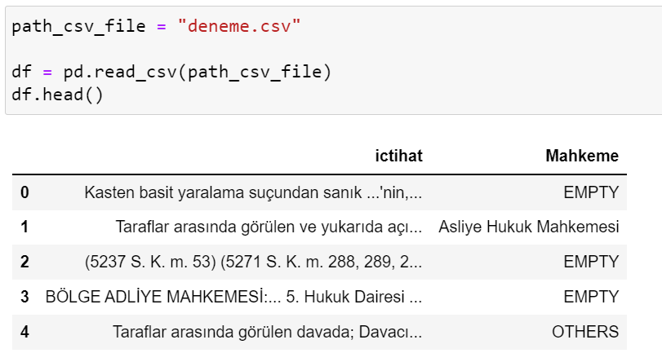
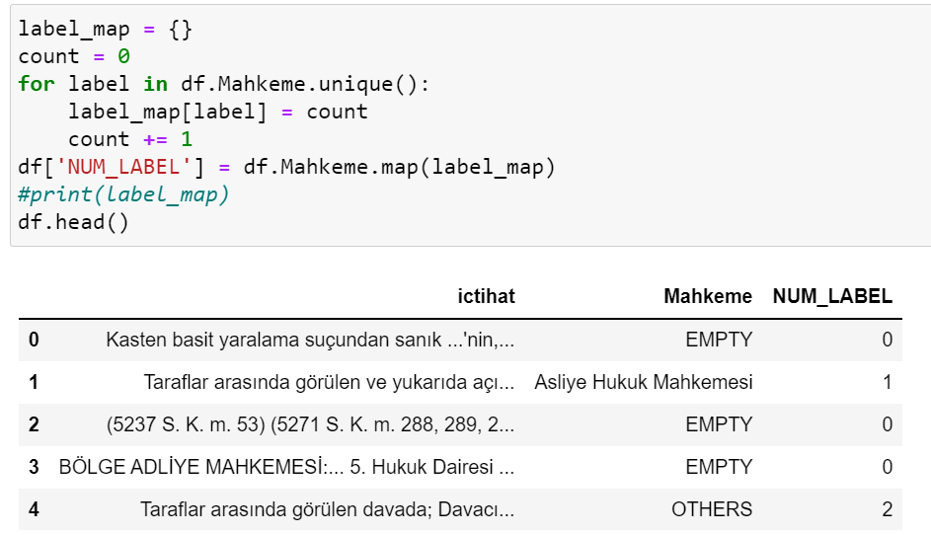
Text Classification With fasttext

Slide 4
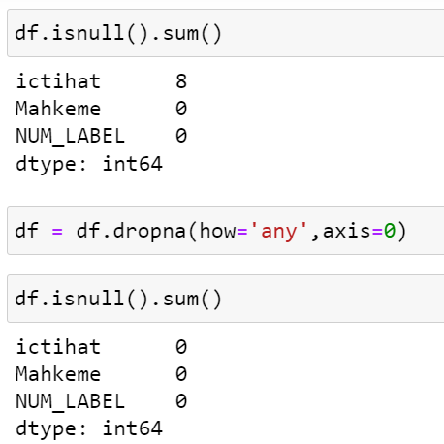
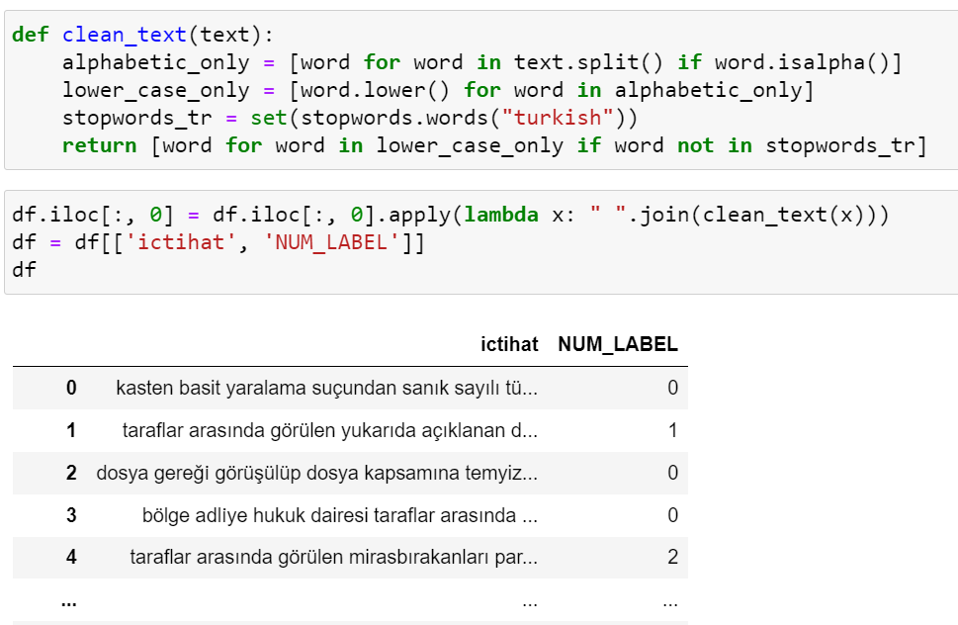
Text Classification With fasttext

Slide 5
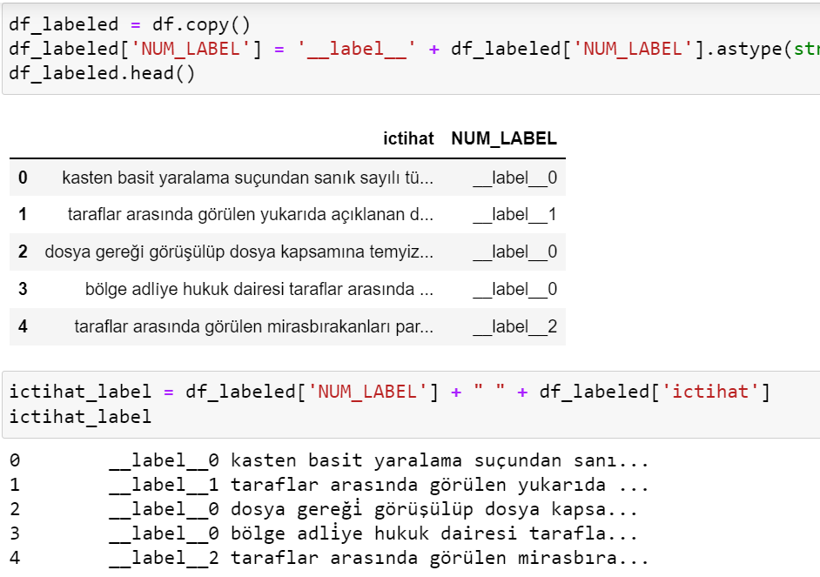
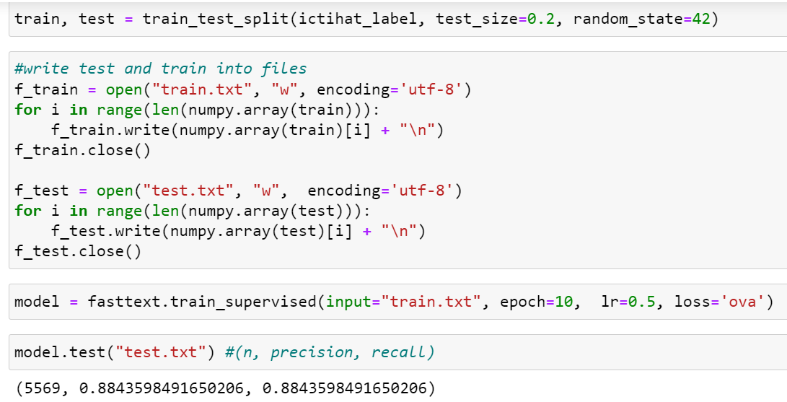
Text Classification With fasttext

Slide 6
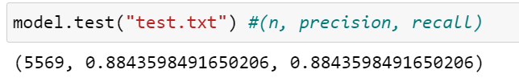
Text Classification With fasttext (Accuracy)

Slide 7
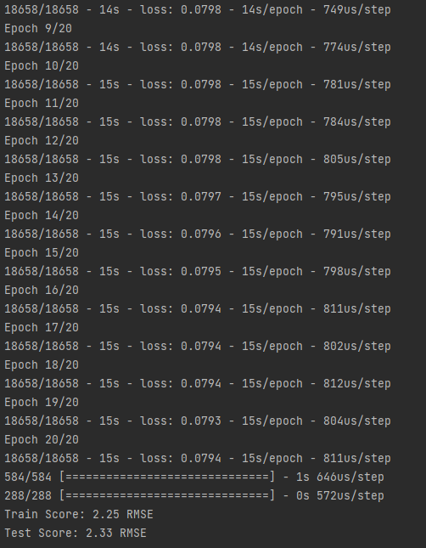
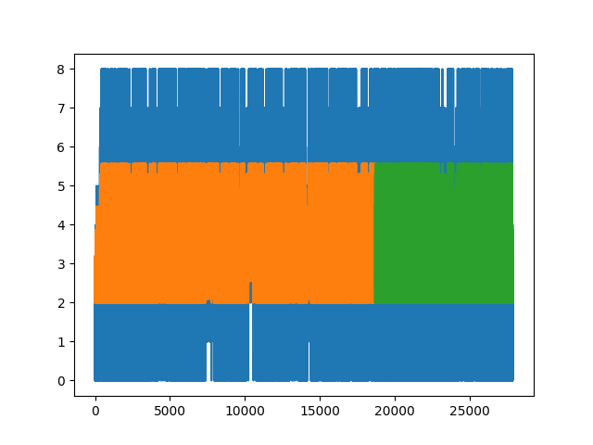
Text Classification With LSTM

